Slide 1
Université Caddi Ayyad
Diffusion Models for Image Generation
Evaluated by:
Presented by:
Dr. Hajar Moussanif
Abouhane Zahra
Bazgour Yassine
Er-remety Karima
16 May 2025

Slide 2
Table of Content
01 | Introduction | 04 | Practical Implementation: From Theory to Code
02 | Diffusion Models and Their Principles | 05 | Adapting Diffusion Models for Your Task
03 | Architecture Behind Diffusion Models | 06 | Conclusion

Slide 3
Introduction

Slide 4

A Diffusion Model is a generative model that gradually transforms random noise into data, leveraging a reverse process of diffusion. The model starts with pure noise and applies a series of denoising steps, producing structured data like images or sound. This approach mimics natural phenomena, like the diffusion of particles, to create complex outputs from simple inputs.

Slide 5

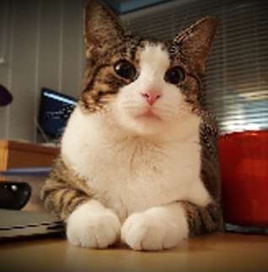
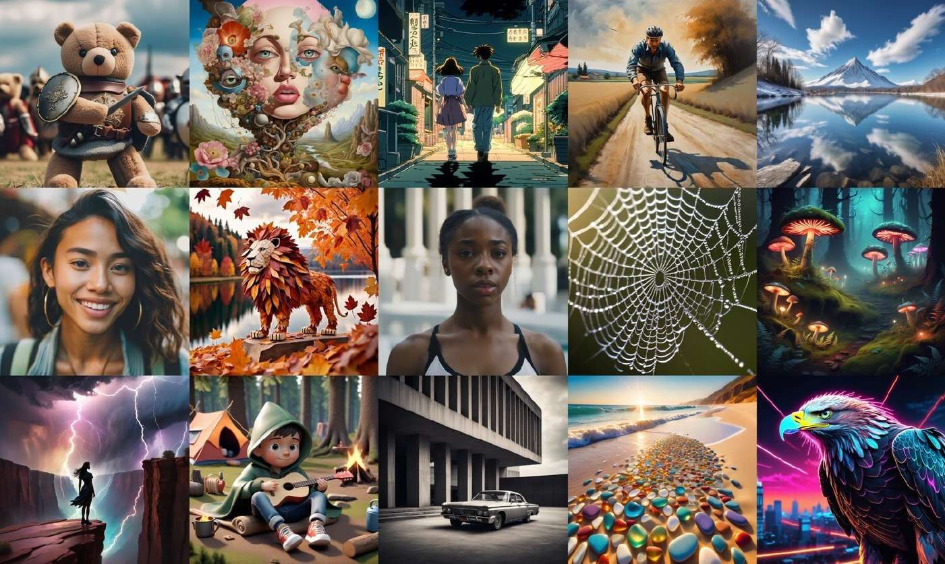
2D Domain
Diffusion Model
2020.06
DDPM
2022.04
DALLE2
2022.05
Imagen
2022.06
Stable Diffusion

Slide 6
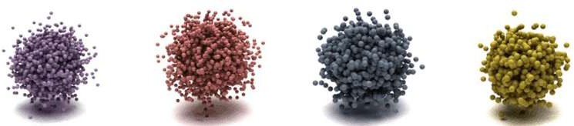




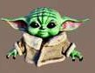
Diffusion Model
3D Domain
2021~
3D Diffusion
A 3D diffusion process can be used to generate an object from point clouds, meshes, or latent spaces.
2021 PVD
2021
Text2Mesh
2023
Dreamfusion
2023
Magic3D
2023
ProlificDreamer
2023
MVdream
7

Slide 7
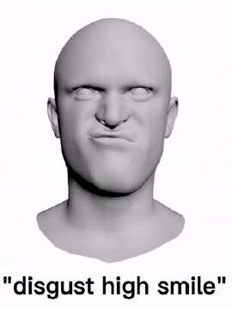
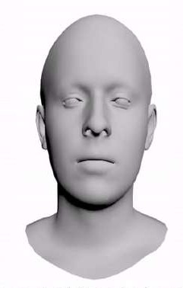
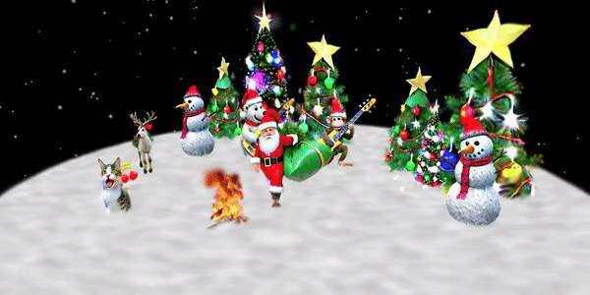
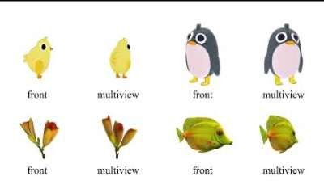
Diffusion Model
4D Domain
2021~
3D Diffusion
2023~
4D Diffusion
Extend the diffusion process domain to 4D, including space and time.
2023
4D Facial Expression
2023
Align Your Gaussian
2023
4DGen

Slide 8
Diffusion Models and Their Principles

Slide 9
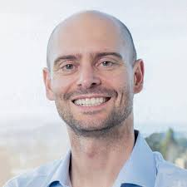
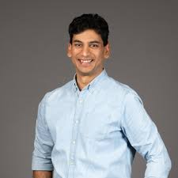
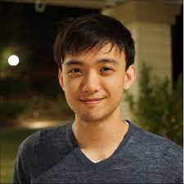
Pieter Abbeel
Ajay Jain
Jonathan Ho

Slide 10
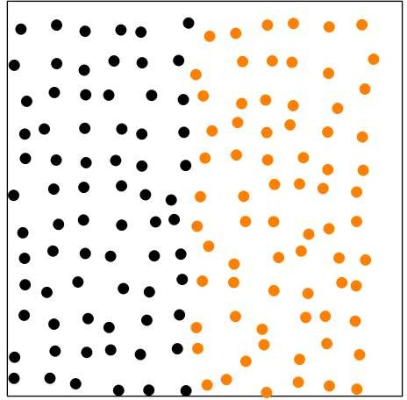
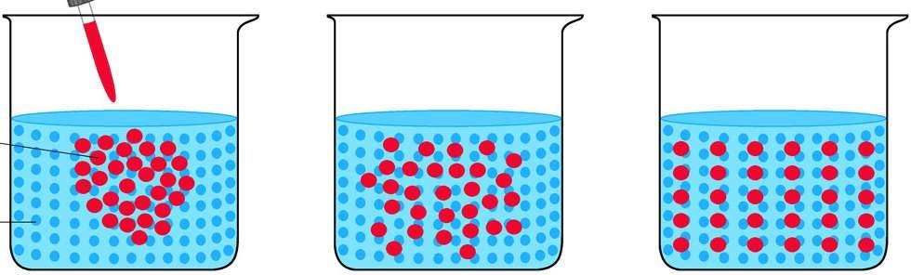

Diffusion Process
Diffusion models are inspired by non-equilibrium thermodynamics.
For a small fraction of the time, it is difficult to determine whether particles are moving in the direction of mixing or in the opposite direction.

Slide 11
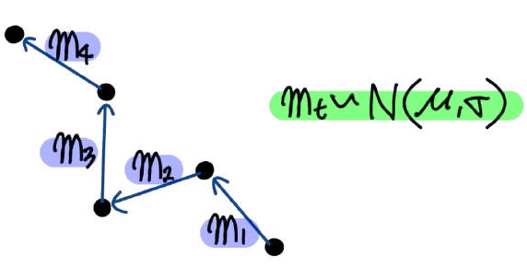
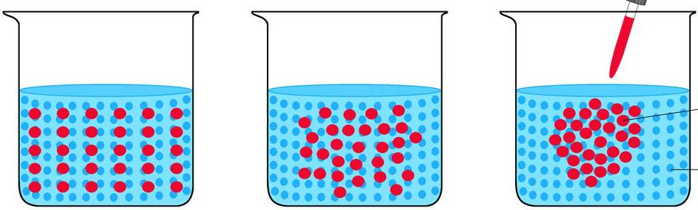
Diffusion Process
If we look at the movement of a single molecule on a very short time scale, it follows a Gaussian distribution.
Since the direction of mixing and the opposite direction are the same in a very short time, the opposite direction also follows a Gaussian distribution.

Slide 12
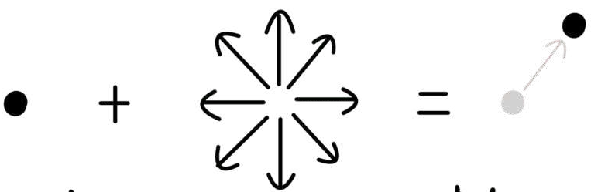

Diffusion Process
Just as we viewed the molecule's motion as a Gaussian-distributed noise, we add a Gaussian-distributed noise to the pixel.
Molecule
Noise movement
Movement
Pixel
Noise
Pixel

Slide 13
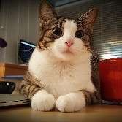

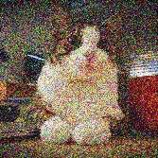
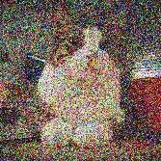
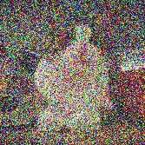
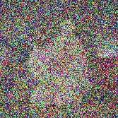
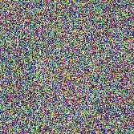
Denoising Diffusion Models
Tutorial on Denoising Diffusion-based Generative Modeling: Foundations and Applications, CVPR 2022
Denoising diffusion models consist of two processes:
Forward diffusion process that gradually adds noise to input
Reverse denoising process that learns to generate data by denoising
Forward diffusion process (fixed)
Data
Noise
Reverse denoising process (generative)

Slide 14
Architecture Behind Diffusion Models

Slide 15
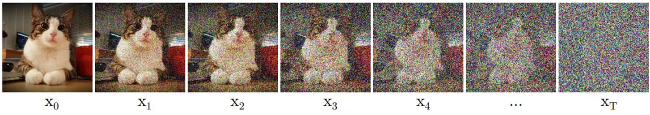
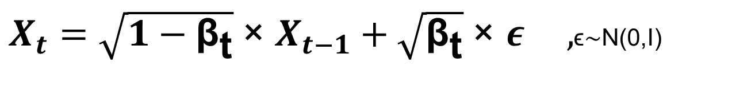
Forward Diffusion Process
Tutorial on Denoising Diffusion-based Generative Modeling: Foundations and Applications, CVPR 2022
The formal definition of the forward process in T steps:
Example:
βₜ = 0.01, then
√(1 - βₜ) ≈ 0.994987 → we’re keeping ~99.5% of the original signal.
$X_{t}=\sqrt{1−{\text{β}}_{\text{t}}} ​​\text{×} X_{t−1}+\sqrt{{\text{β}}_{\text{t}}}​​ \text{×} ε ,$ϵ∼N(0,I)

Slide 16
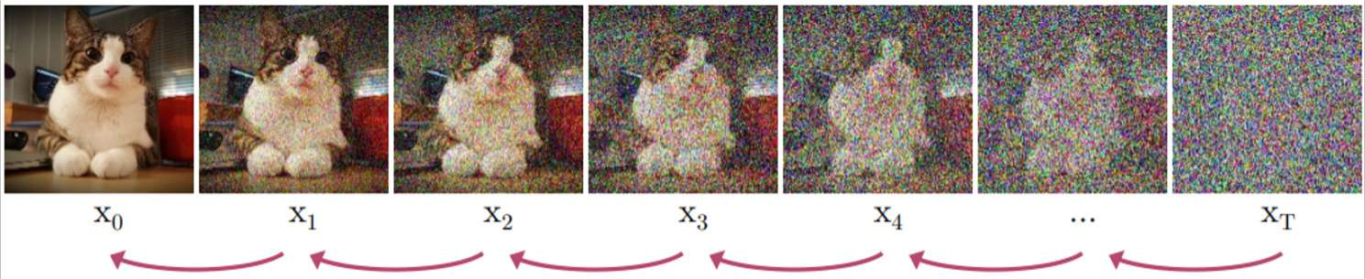

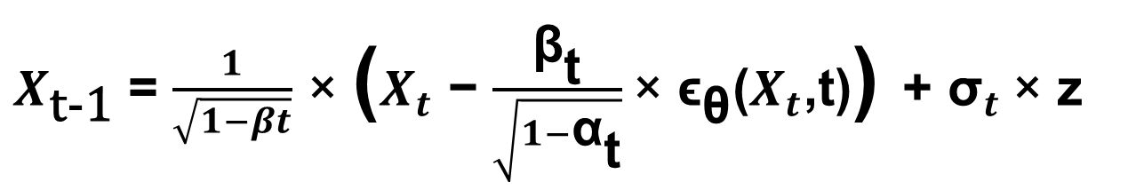
Reverse Denoising Process
Tutorial on Denoising Diffusion-based Generative Modeling: Foundations and Applications, CVPR 2022
Formal definition of forward and reverse processes in T steps:
$X_{\text{t}\text{-1}}$​ = $\frac{1}{\sqrt{1−βt}}$ $\text{×}$ ​($X_{t}$​ − $\frac{{\text{β}}_{\text{t}}\text{​}}{\sqrt{1−{\text{α}}_{\text{t}}\text{​}}}$​$\text{×}$ ${\text{ϵ}}_{\text{θ}}$($X_{t}$,t)) + ${\text{σ}}_{t} \text{×}$ z
Xt​: noisy image at step t
Xt−1​: denoised image at step t−1
βt​: noise variance at step t
αˉt​: cumulative signal preservation
ϵθ​(Xt​,t): predicted noise by U-Net
σt​: noise scale for stochasticity
z: standard Gaussian noise sample

Slide 17
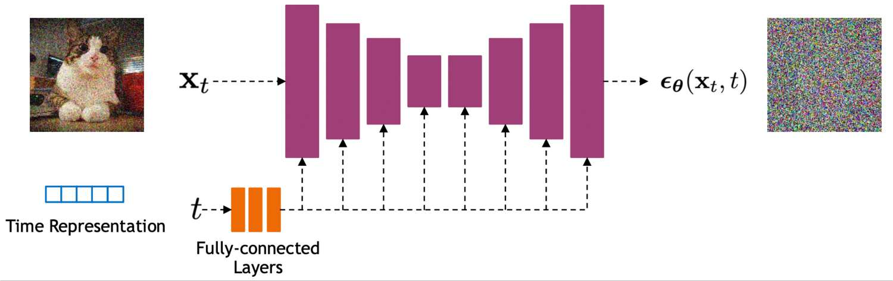
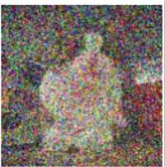
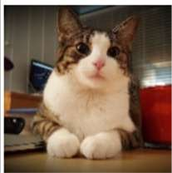
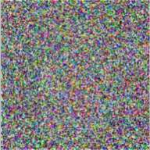
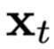
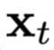
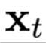
Denoising Diffusion Models : Training
Tutorial on Denoising Diffusion-based Generative Modeling: Foundations and Applications, CVPR 2022
0
-1
T
U-Net

Slide 18

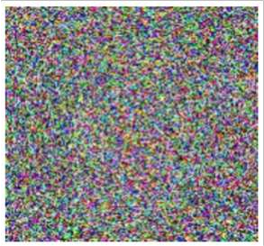
Results
Diffusion

Slide 19
Diffusion Model
Pros
Intuitive Understanding: Diffusion in pixel space directly affects image pixels, making the changes visually easy to understand.
Cons
Computational Cost
: The larger the number of pixels, the greater the computation.
Memory Usage
: Handling high-resolution images requires substantial memory.

Slide 20
Latent Diffusion Model
Latent spaces typically have lower dimensions than pixel spaces, resulting in lower computational costs.
Pixel Space >> Latent Space
Pixel | Noise | Pixel
Latent | Noise | Latent

Slide 21
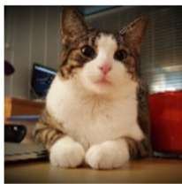
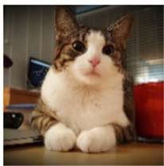

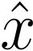
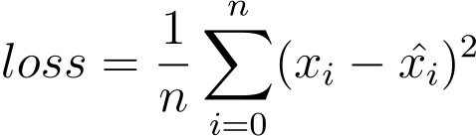
Latent Diffusion Model
Autoencoders can be particularly valuable as they enable a compressed yet remaining semantic and conceptual meaning of an image.
Encoder
Decoder
Compressed Data

Slide 22
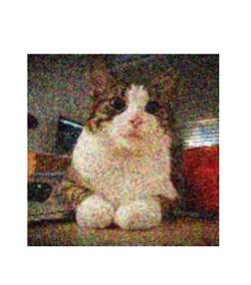
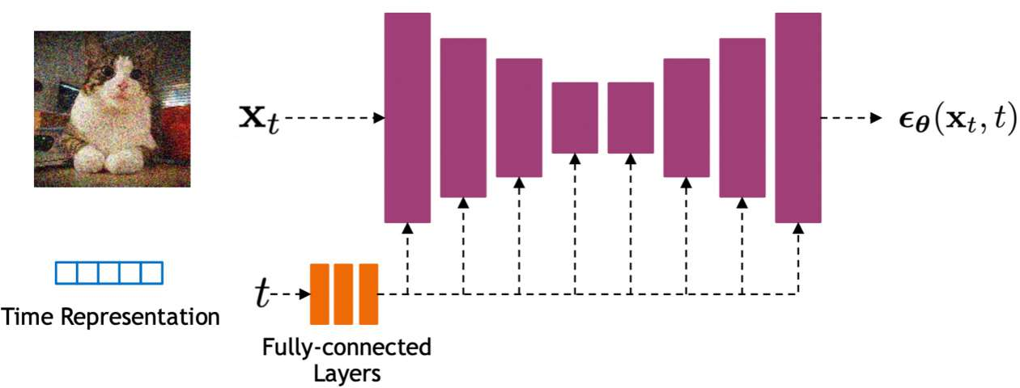
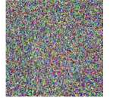
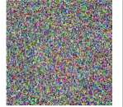

Latent Diffusion Model
Runs the diffusion process in the latent space instead of pixel space
2 Stage Training : Auto-Encoder + Latent Diffusion
feature

Slide 23
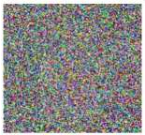
Results
Decoder
Diffusion

Slide 24
Questions?

Slide 25
Lab1 : From Theory to Code

Slide 26
Lab2 : Adapting a Diffusion Model

Slide 27
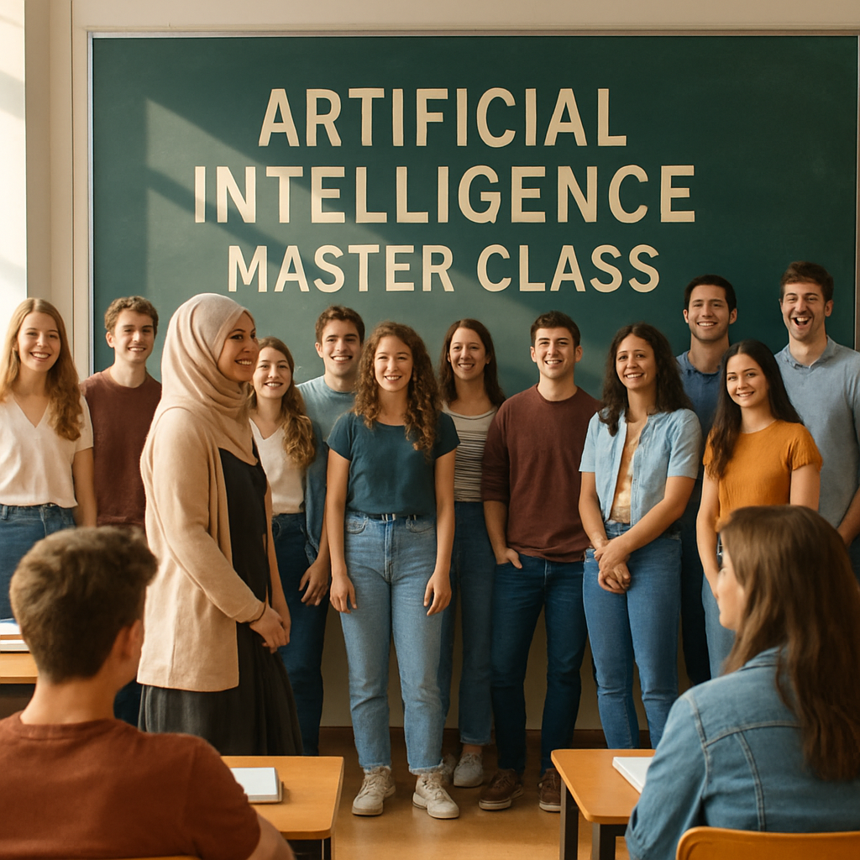
PROMPT
Generate a high-resolution image depicting an artificial intelligence master class setting.The scene is captured from the back of the classroom, showcasing a diverse group of approximately 10 to 15 first-year students, around 22 years old, with a balanced gender representation.They are positioned in front of a blackboard, smiling and engaged.In front of the students stands their coordinator, a woman wearing a hijab and a long skirt, also smiling.The atmosphere is sunny, enhancing the cheerful mood of the class.Ensure that the composition highlights the camaraderie and enthusiasm of the students in the context of their learning environment.

Slide 28
Conclusion

Slide 29

Thank You!

